Slide 1
High-Throughput experiments and Rosetta Design
Alex Sevy
Rosetta Workshop
May 2018

Slide 2
Computation can increase scale of protein engineering
Number of proteins evaluated
10⁰
10¹
10²
10³
10⁴
10⁵
10⁶
10⁷
10⁸
10⁹
10¹⁰
Recombinant expression
Yeast display
Phage
display
In-silico analysis
Small protein such as ubiquitin has 76 aa – sequence space 10⁹⁸
Antibody CDR loop may have 16 amino acids – 20¹⁶ (~10²⁰) possibilities
How to test a large number of designs?

Slide 3
Phage/yeast display
Phage display
Yeast display
Protein of interest can be physically linked to the surface of a phage particle or yeast cell which contains its gene
Functional proteins can then be isolated and sequenced
Chao, G. et al. Isolating and engineering human antibodies using yeast surface display. Nat Protoc 1, 755–768 (2006).
Smith J, Kontermann RE, Embleton J, Kumar S. Antibody phage display technologies with special reference to angiogenesis. FASEB J. 2005;19(3):331-41.

Slide 4
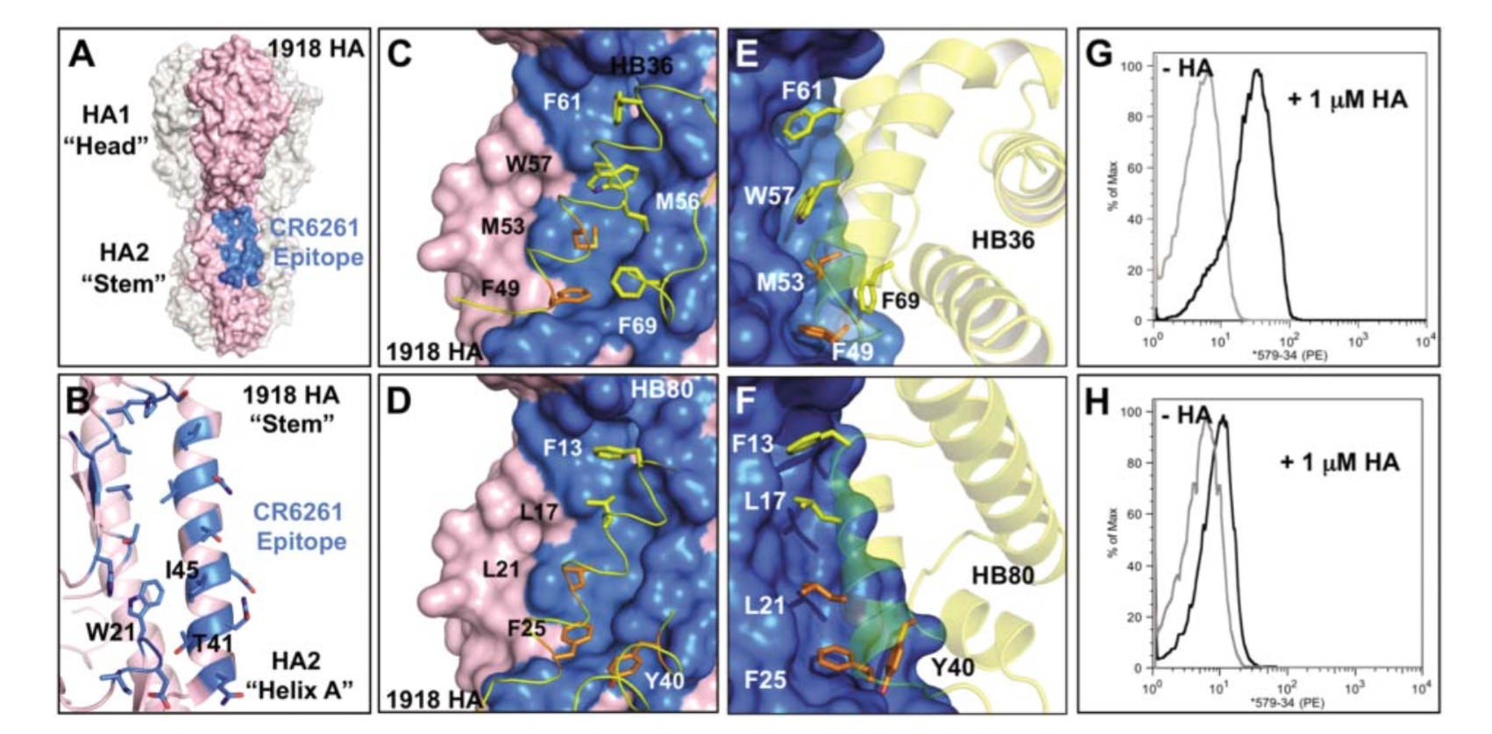
Affinity maturation of protein binder
Rosetta-based design of a novel protein targeting the stem region of influenza hemagglutinin
Initial proteins bound with low affinity – random mutagenesis generated proteins with nanomolar affinity
Fleishman, S. J. et al. Computational design of proteins targeting the conserved stem region of influenza hemagglutinin. Science 332, 816–821 (2011).

Slide 5
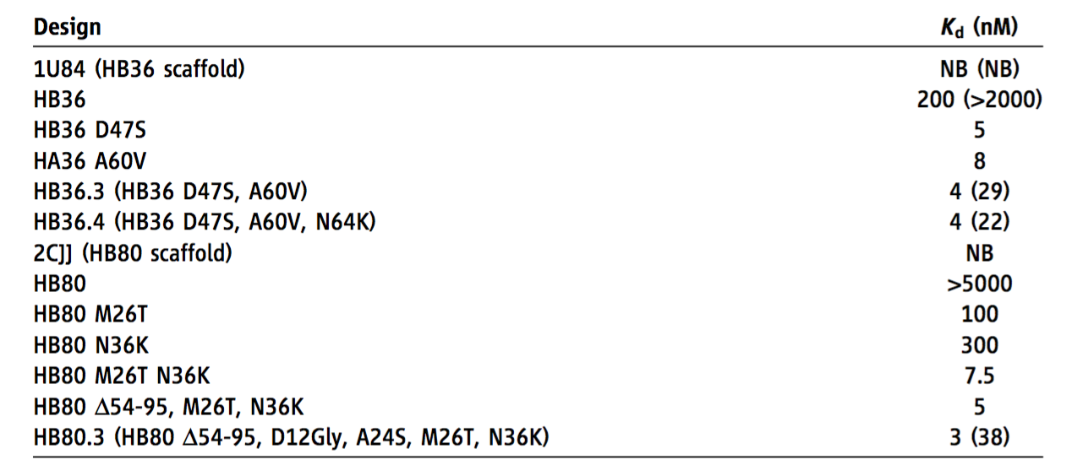
Affinity maturation of protein binder
Designed protein
Affinity-matured variants
Designed protein
Affinity-matured variants
Fleishman, S. J. et al. Computational design of proteins targeting the conserved stem region of influenza hemagglutinin. Science 332, 816–821 (2011).

Slide 6
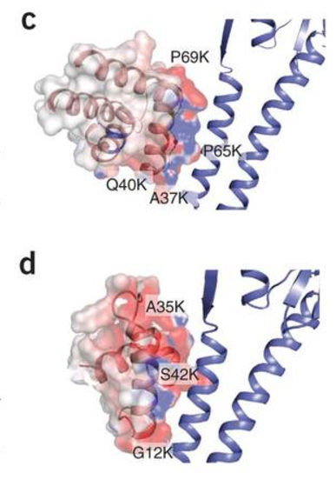
Comprehensive mutagenesis of influenza binders
Whitehead TA, Chevalier A, Song Y, et al. Optimization of affinity, specificity and function of designed influenza inhibitors using deep sequencing. Nat Biotechnol. 2012;30(6):543-8.
Experimental mutations improve electrostatics at the interface –
Electrostatics were not included in original design calculations

Slide 7
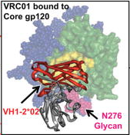
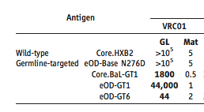
Design of HIV vaccine immunogens
Used Rosetta to create an immunogen that binds to precursors of known broadly neutralizing antibodies
Identified computationally designed antigens with μM affinity for target by building targeted libraries
Further increased affinity by random mutagenesis
Antibody
Jardine, J. et al. Rational HIV immunogen design to target specific germline B cell receptors. Science 340, 711–716 (2013).

Slide 8
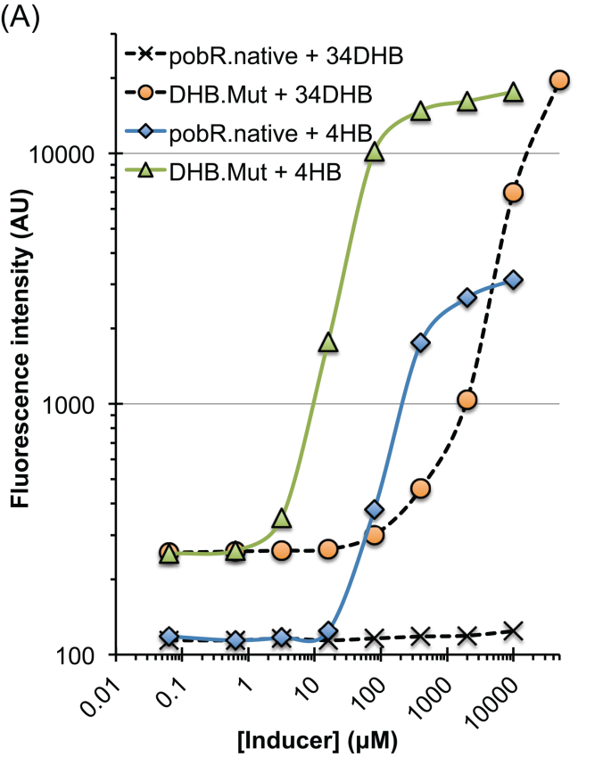
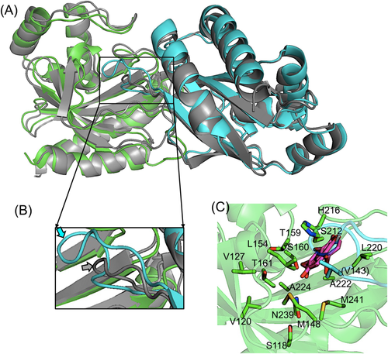
Rosetta comparative modeling for library design
Wanted to engineer a transcription factor with no structure for recognition of small molecule
Created a homology model and docked the ligand
Made a library mutated at 16 positions predicted to contact ligand
34DHB – ligand target
Jha, R. K., Chakraborti, S., Kern, T. L., Fox, D. T. & Strauss, C. E. M. Rosetta comparative modeling for library design: Engineering alternative inducer specificity in a transcription factor. Proteins 83, 1327–1340 (2015).
Notes:
Each position mutated to 3 aas from BLOSUM matrix

Slide 9
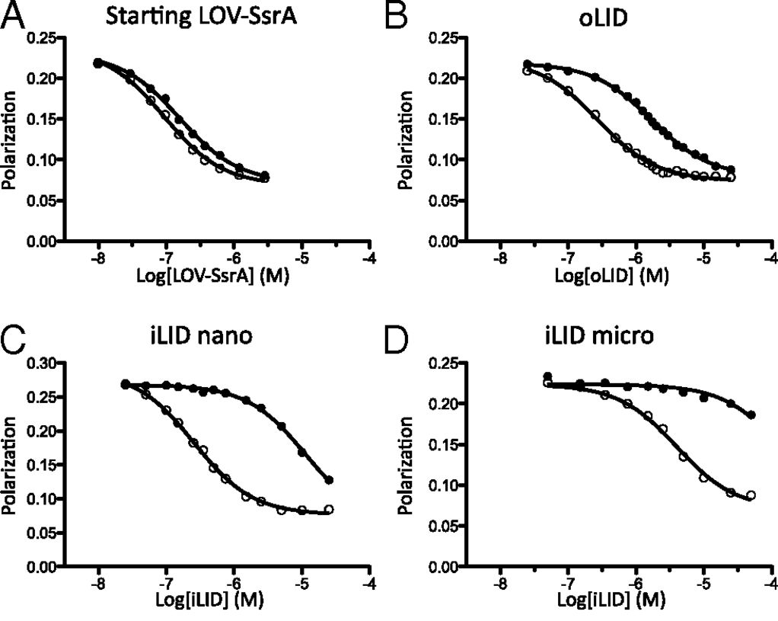
Engineering an improved light-induced dimer (iLID)
Design of a protein which heterodimerizes in the presence of blue light
Initial protein had 2 fold difference between dark and light binding
Scanned the protein for all point mutants in Rosetta, chose 743 at 49 positions for characterization
Displayed and screened mutants by phage display
Guntas, G. et al. Engineering an improved light-induced dimer (iLID) for controlling the localization and activity of signaling proteins. Proc. Natl. Acad. Sci. U.S.A. 112, 112–117 (2015).

Slide 10
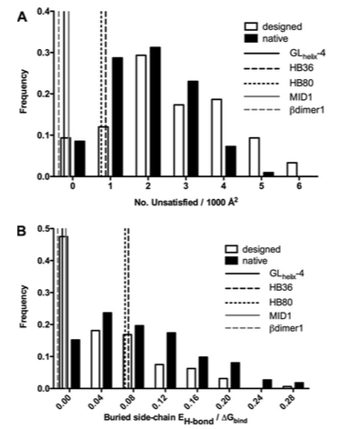
A comparison of successful and failed protein interface designs
Comparison of 5 successful de novo interface designs with 158 failures
Successful designs have fewer polar atoms at the interface
Predicted hydrogen bond networks at the interface almost never materialize, even though these are common in natural interfaces
Stranges, P. B. & Kuhlman, B. A comparison of successful and failed protein interface designs highlights the challenges of designing buried hydrogen bonds. Protein Science 22, 74–82 (2013).

Slide 11
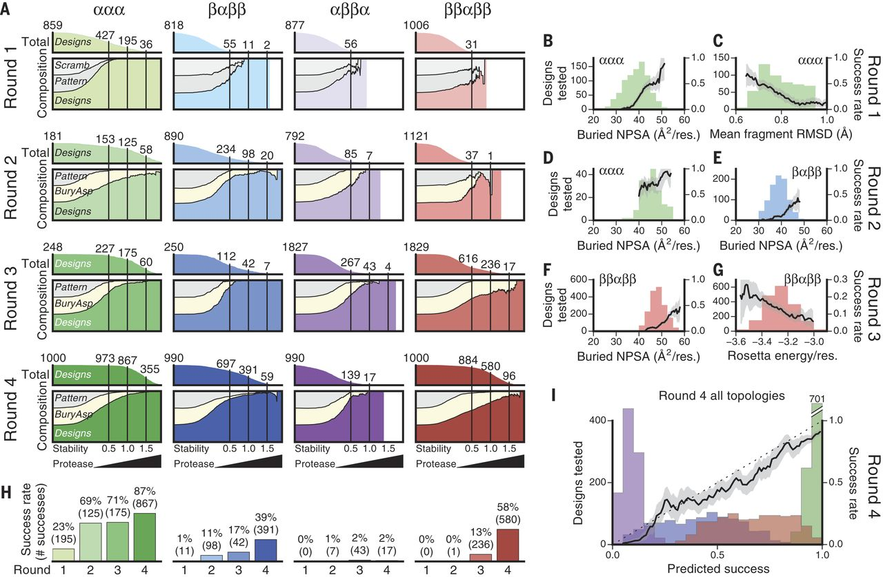
Global analysis of protein folding using massively parallel design, synthesis, and testing
Buried nonpolar surface area (NPSA) is a major contributor to design success
Mean fragment RMSD also contributes to successful designs
Expression of massive (10⁴) panels of designed small proteins on yeast surface
Measurement of protease resistant as a surrogate for protein stability
Identified >2,500 proteins which fold stably
Rocklin, G. J. et al. Global analysis of protein folding using massively parallel design, synthesis, and testing. Science 357, 168–175 (2017).

Slide 12
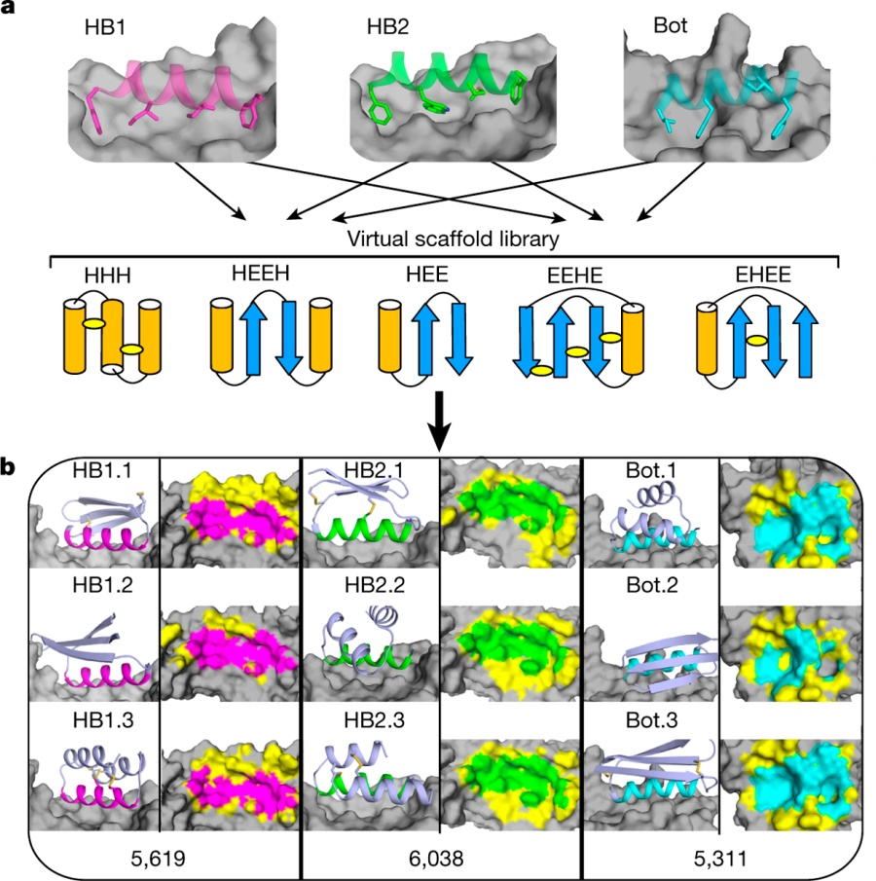
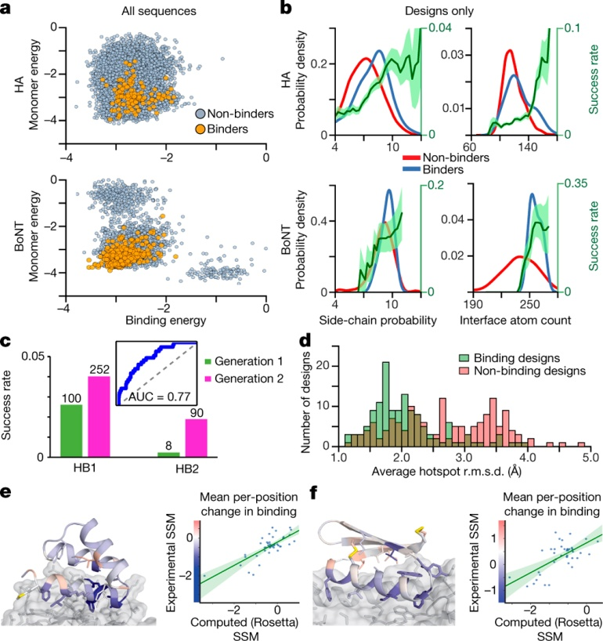
Massively parallel de novo protein design for targeted therapeutics
Expression of 22,660 small protein scaffolds designed to bind either influenza HA or botulinum neurotoxin B
Obtained 115 HA and 2,685 BoNT binders
Lower monomer energy and binding energy corresponds to experimental success
Local sequence-structure compatibility and the numbers of contacts across the interface also contributed
Chevalier, A. et al. Massively parallel de novo protein design for targeted therapeutics. Nature 550, 74–79 (2017).
Notes:
They were able to increase success rate by implement a second generation of designs with these principles in mind

